Slide 1
MINOR PROJECT PLATFORMER GAME
BY- ASHISH DHARVE
UNI. ROLL NO.-22020107002
COLLEGE ROLL NO.- 20222719
GITHUB REPOSITORY

Slide 2
INTRODUCTION
NOTE:
To change images on this slide, select a picture and delete it. Then click the Insert Picture icon
in the placeholder to insert your own image.
HopBunny is a 2D platformer game developed using Unity, with player controlled character with obstacles filled levels.
Key Elements:
Player controls and interactions.
Hazard Mechanics
Platform Dynamics
Real Time Physics
Seamless Animation

Slide 3
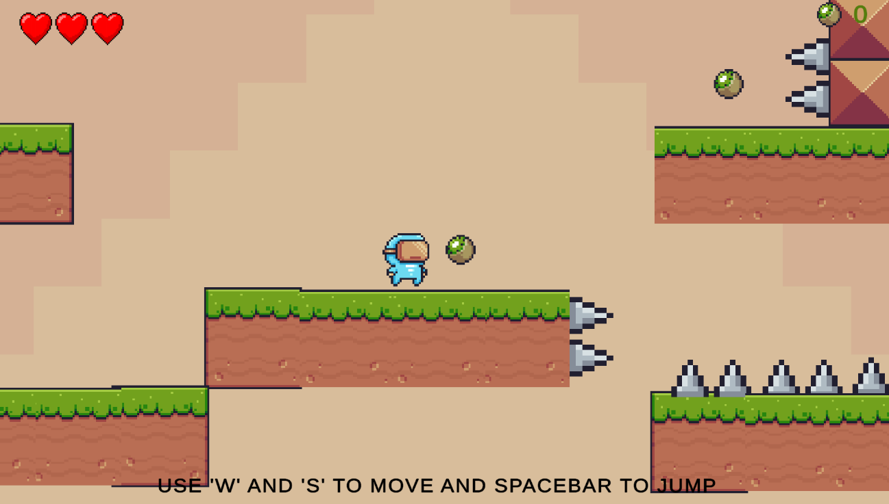
Objective of the Game
Primary Goal: Provide a fun and engaging 2D platformer experience.
Player Goals:
Navigate through levels while avoiding traps and hazards.
Collect as many kiwis as possible to increase score.
Reach the goal site to clear the level and advance to the next stage.

Slide 4

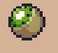

Features
Player Movement: Walking and Running: Control the player with arrow keys or WASD.
Jumping: Leap between platforms and over obstacles using Spacebar.
Level Design: Multiple Levels: Increasing difficulty with each level.
Moving Platforms: Horizontal, vertical, and rotating platforms.
Traps and Hazards: Spikes, moving saws, and spikeheads.
Collectibles:
Kiwis: Gather them to increase your score.
UI and HUD:
Health Bar: Tracks remaining health.
Score Counter: Displays the player’s score.
MOVING SAW
KIWI
HEALTHBAR

Slide 5
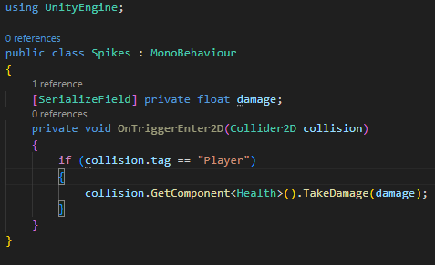
Technology and Scripts
Technology Used:
Unity: Game engine for designing levels, implementing mechanics, and managing assets.
C#: Primary scripting language for game logic and mechanics.
Git: Version control system for collaboration and project management.
Key Scripts:
PlayerController Script: Handles player movement and interactions.
LevelController Script: Manages level transitions using Unity's SceneManager.
Spike Script: Detects player collision with spikes.

Slide 6
System Architecture
Player: Controlled by PlayerController script for movement and jumping.
Environment: Platform (static and moving).
Traps and hazards(spikes, saws) managed by respective scripts.
UI : Health Bar to show player’s remaining lives.
Score Counter for collected Kiwis.
Game Progression: Managed by LevelController Script.

Slide 7
How to Run the Game
Prerequisites:
Unity Hub and Unity version 2022.3.45f1. or higher.
Git for cloning the repository.
Steps to Run the Game:
Clone the Repository: https://github.com/ashishdharve09/Game_College_Project.git
Open the Project in Unity:
Launch Unity Hub.
Click “Add” and select the project folder.
Wait for Unity to load the project.
Play the Game: Press the “Play” button in the Unity Editor to start.
Alternative :
You can directly play the game without unity, just download this github file : Game

Slide 8
Future Scope
Add more levels with diverse challenges and mechanics.
Introduce new collectibles and power-ups for enhanced gameplay.
Implement advanced features such as multiplayer mode or leaderboard integration.
Optimize the game for mobile and web platforms for broader accessibility.

